Slide 1

An Adaptive Synchronous Parallel (ASP) Strategy for Distributed Machine Learning
A presentation by
19141024 Daiyan Khan (slide 1-4)
21166005 Md. Mamun-Or-Rashid (slide 5-7)
20266003 Sanowar Hossain Raja (slide 8-9)
21141044 Md Muyeed Shahriar (slide 10-11)
21166001 Redwanuzzaman (slide 12-15)

Slide 2
What is Distributed ML?
Related
Works
Current age of Big Data means large volumes of data and higher model complexity
Single computational nodes cannot handle the load
Thus, Distributed Systems are used to train large-scale ML models
Parameter Server Framework
Bulk Synchronous Parallel
Stale Synchronous Parallel

Slide 3
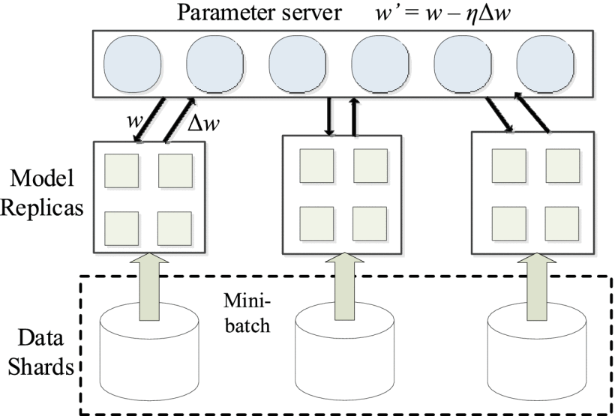
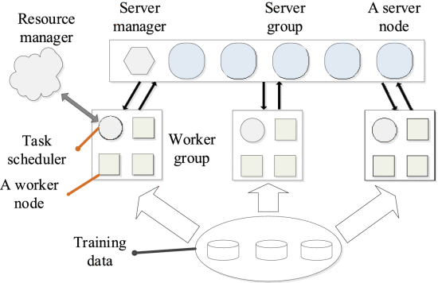
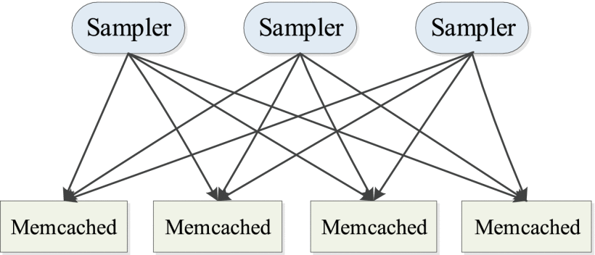
Three Generations of a Parameter Server Framework
1st generation
2nd generation
3rd
generation
Each parameter server contains set of global parameters
Servers communicate with each other
Server manager controls servers, task scheduler controls nodes
Does not account for external disturbances
Parameter server communicates with
nodes directly
No communication
between nodes
Does not consider separate performance of each node
Distributed shared
storage framework
Sampler can access
global parameters
Simple concept, unoptimised for ML

Slide 4
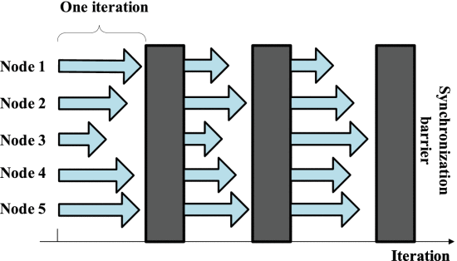
Bulk Synchronous Parallel
Each node stops at a sync barrier after uploading parameters of 1 iteration
Has to wait till all nodes have completed 1 iteration
Limited by computational speed of least powerful node

Slide 5
Stale Synchronous Parallel
Due to the iterative-convergence nature of most ML algorithms, SSP does not use a synchronization barrier immediately after an iteration.
Therefore, the computational nodes can perform the next iteration directly instead of waiting for other computational nodes to finish.
However, there are two obvious drawbacks with SSP.
The first drawback is that SSP cannot optimize a distributed ML algorithm that is running on the cluster, which consists of similar-performance computational nodes.
The second drawback of SSP arises, without considering the extraneous factors that can disturb the model training process.

Slide 6
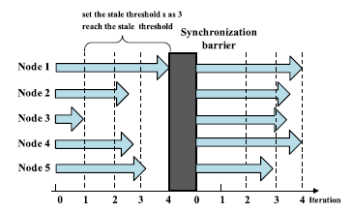
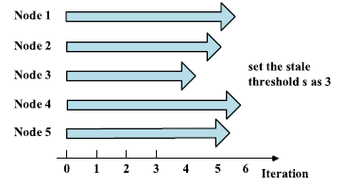
STALE SYNCHRONOUS PARALLEL (Continue…)
Cluster of nodes with similar performance running a distributed ML algorithm.
The training model may encounter external influences.

Slide 7

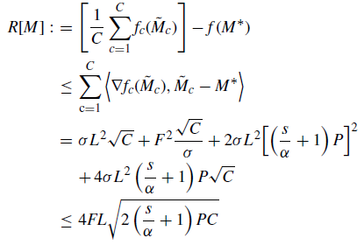
DYNAMIC COMMUNICATION STRATEGY
THEORETICAL ANALYSIS OF ASP

Slide 8
DYNAMIC COMMUNICATION STRATEGY
PERFORMANCE MONITORING MODEL
09.05.XX
09.17.XX
10.20.XX
11.01.XX
The CPU Utilization
Memory Utilization
I/O Load
Network Traffic
Hard Disk Utilization

Slide 9
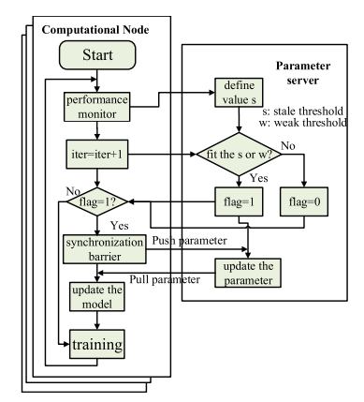
ADAPTIVE SYNCHRONOUS PARALLEL STRATEGY
Improves upon SSP
Computational Node
Parameter Server

Slide 10
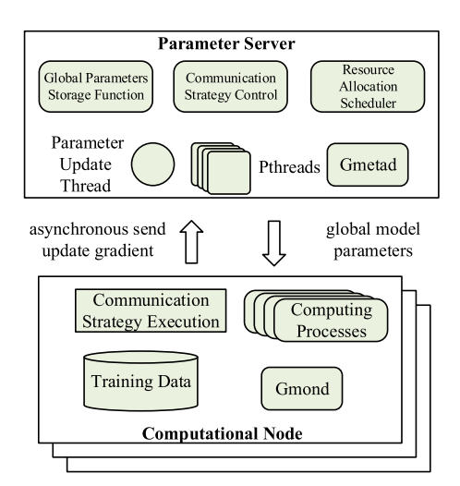
Environment
The distributed deep learning framework that is based on Caffe is implemented by ASP and the parameter server.
The global parameter storage function is a vector-valued function that ensures that the global model parameters are up to date.
A thread is set up to calculate and update the global model parameters through the local model parameters, which are transmitted by the computational nodes.
Each computing process in the computational nodes has a corresponding POSIX thread in the parameter server, which is responsible for communicating information to the computational nodes.
The computing process is designed to train the ML model using data parallelism.
This framework is implemented by using 4 nodes and connect them with gigabit Ethernet. Each node is configured with 16 cores of a 2.4 GHz AMD Opteron processor (Processor 6136) and 32 GB of RAM, running on top of CentOS7.0.

Slide 11
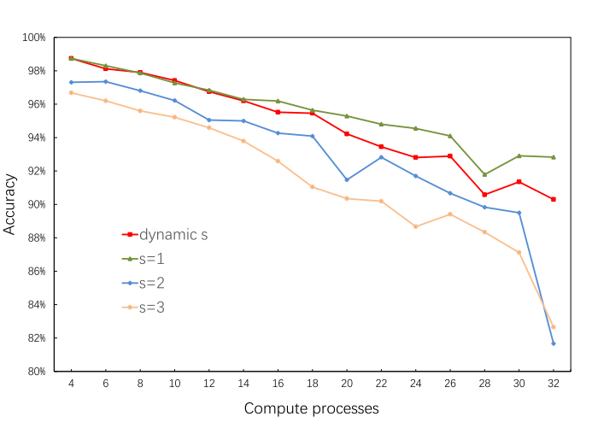
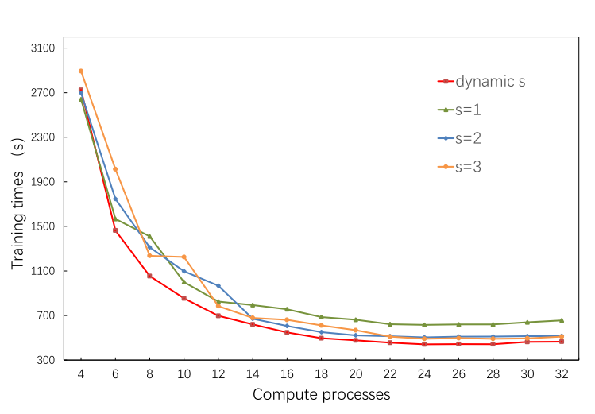
EFFECTIVENESS AND PERFORMANCE OF ASP
ML model training iterations reaches 5000, this experiment adds an interference programme to the computational nodes to simulate the dynamic change in the performances of the computational nodes
Using SSP or ASP to train the ML model, the accuracy is reduced as the number of processes increases. (First Graph)
Due to communication between computational nodes and the parameter server, the training time does not decrease linearly as the number of computing processes increases; beyond a certain number of computing processes, the training time increases.(Second Graph)
The distributed ML model with ASP reduces the training time while ensuring a certain accuracy.
Confirms good performance through this strategy.

Slide 12
Extensibility of the ASP Strategy
We apply four nodes in the ML framework to train distributed ML models, where one node acts as a parameter server and the others as computational nodes.
To maintain balance, the training processes are evenly distributed among the three computational nodes.
We set the values ​​of s to 1, 2, and 3 in SSP and ASP dynamically adjusts the values ​​of s. In both strategies, we set the value of w to 1.
The other terms are the same as in paragraph 4.2. Specific results can be seen in Figures 13 and 14.

Slide 13
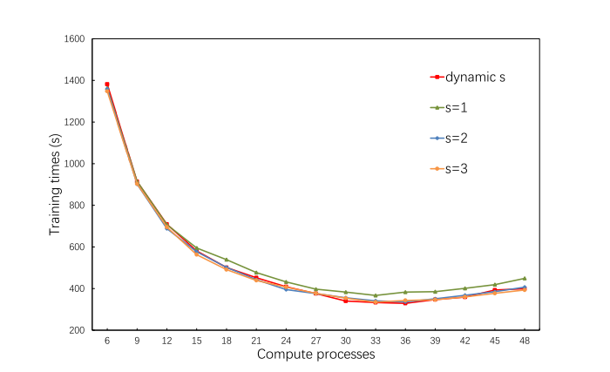
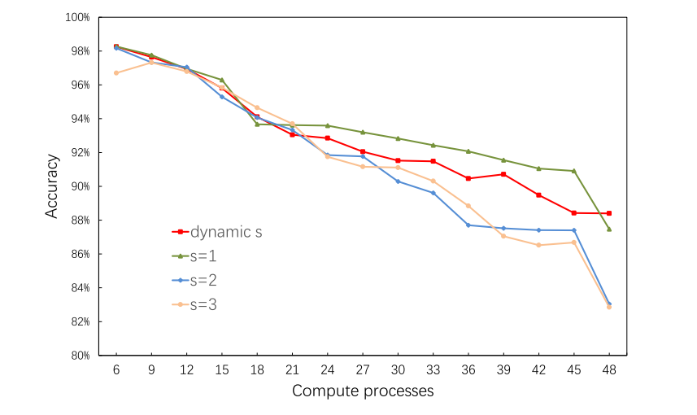
Continue…….
[Fig-13] Verification of the extensibility of ASP based on the accuracy of the ML model.
[Fig-14] Verification of the extensibility of ASP based on the training time of the ML model.

Slide 14
Conclusion
Training of ML models delivered with SSP can reduce communication and synchronization costs and improve the usage rate and computational efficiency of computational nodes.
We propose a new communication strategy called ASP, which adds a weaker threshold and dynamically adjusts the stale threshold and improves performance based on the monitoring data obtained by Ganglia to balance training time and model accuracy. Distributed ML algorithm.
Experimental results show that ASP can guarantee better accuracy and achieve higher convergence speeds than SSP and HAS
Better extensibility.

Slide 15
Thank You

